Slide 1
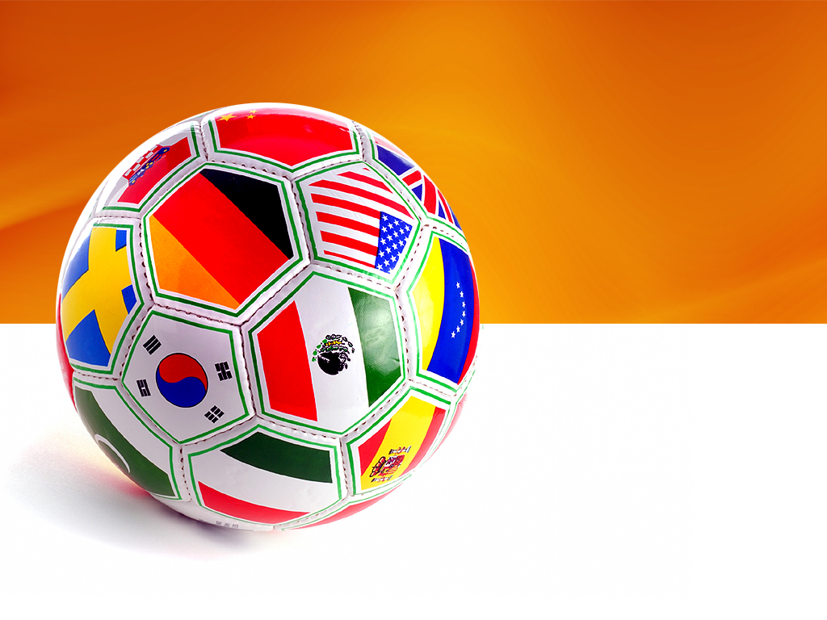
FIFA World Cup 2022 Simulation
IS 597 Programming Analytics
School of Information ,UIUC
By - Rajat Kumar
Contact – rajat3@illinois.edu
https://github.com/rajat3Illinois/2021_Spring_finals

Slide 2
Tables of Content
Guess the Players (Fun Activity)
Introduction about the FIFA World Cup
Purpose of the Project
Approach
Data Sets Sources
Hypothesis
Keen Observations and Design Process
Results so far
Improvisation and Future Scope
References
Questions / Suggestions

Slide 3

Guess the Players ??? (Fun Activity)

Slide 4
Introduction
The FIFA World Cup is the most widely viewed and followed sporting event in the world.
32 teams qualify for the tournament with the host nation given an automatic qualification.
The qualified team comes from six confederations (continents):
CAF (Africa)
AFC (Asia)
CONENBOL (South America)
CONCACAF (North America)
Oceania
UEFA (Europe)
Tournament Format is as follow :-
Group Stages (32 teams split into 8 groups)
Last -16 Stage (Top 2 teams from each group qualify)
Quarter-Final
Semi-Final
Final

Slide 5
Project Purpose
With this Project, I aim to enhance the previously developed World Cup 2018 simulation from the Programming Analytics Spring 2018 students and making an enhanced simulation for the World Cup 2022. (Type III analysis)
Previous Project Link: - https://github.com/hiralrayani/World-Cup-Simulator.git
Loopholes in Previous Project:-
The previous simulation, assumed that toss would play a key role in deciding the match result.
It didn’t consider the pot seedings based on ranking in assigning the teams into various groups.
Randomly assigning the team the attacking prowess and defensive prowess based on their current rankings from the range of 38 to 83.
There were no consideration for the players data belonging to each team to compute the teams attacking, defensive and goalkeeper strength.

Slide 6
Approach
We will first compute the teams that are likely to qualify for the World Cup.
The qualification of the team is based on the following factors:-
Current ranking (normalized for each confederation while calculation)
Attacking prowess (Using Avg Attacking Players Rating)
Defensive prowess (Using Avg Defensive Players Rating)
Goalkeeper prowess (Using Avg Goalkeeper Players Rating)
Median player rating.
Total market value of the Players in the team.
Number of teams that can qualify from each consideration.
All teams qualified (with host nation Qatar given direct entry), then are split into the 8 groups.
The groups of each team is based on Pots Seeding as explained in upcoming slides.

Slide 7
Approach
The teams in groups is dependent on Pots Seeding.
The 4 pots similar to the one below predominantly defines the groups of each team. The host nation Qatar automatically is put to the Pot1.
Teams in the pots are officially decided as per their ranking.
Once the pots are filled as per qualified team ranking, the 8 groups are randomly constructed, with each group containing one team from every Pot.
Pot 1 | Pot 2 | Pot 3 | Pot 4
Qatar (Host)

Slide 8
Data Sets Sources
Fifa 20 Players: https://www.kaggle.com/stefanoleone992/fifa-20-complete-player-dataset
Latest FIFA Ranking: https://www.fifa.com/fifa-world-ranking/ranking-table/men/
https://www.transfermarkt.us/statistik/weltrangliste
Various Confederation data, constructed through Wikipedia.
UEFA.csv
Asia.csv
AFC.csv
NorthAmerica.csv
SouthAmerica.csv
Oceania.csv

Slide 9
Hypothesis
The curse of defending champion (France) bowing out from the Group Stage and / or not even making the world cup is highly unlikely.
It is highly likely that the host nation would qualify for the knockout stages.

Slide 10
Design Process and Key Observation
Key Observations: -
Keen observation and pre-processing is crucial on the players_20 dataset containing the details of rating, market value, team position and nationality.
During the design process, it was noticed that there is a mismatch in the nation names as per the Team Ranking dataset and dataset.
For handling the above scenarios, proper pre-processing of data is undertaken.
Design Process: -
Keeping in mind all the above key observations and the relevant dataset, Panda’s data frame is predominantly used.
Since, it involves the team data stats, an OOP design defining the Team objects is developed, providing the necessary feasibility to output the results after every simulation.

Slide 11
Results so far (In process):-
Based on the design process and the data set.
Qualified Team Pots;
Pot 1 | Pot 2 | Pot 3 | Pot 4
Qatar | Mexico | Poland | Morocco
Uruguay | Italy | Senegal | South Korea
Spain | Croatia | Sweden | Costa Rica
Argentina | Denmark | United States | Ghana
Portugal | Germany | Japan | Ivory Coast
England | Netherlands | Iran | Saudi Arabia
France | Columbia | Serbia | Canada
Brazil | Chile | Turkey | New Zealand

Slide 12
Results so far (contd.):-
Based on the previous pots, one of possible Groups of team could be as follows:-
Group A | Group B | Group C | Group D | Group E | Group F | Group G | Group H
Brazil | France | Spain | England | Qatar | Uruguay | Argentina | Portugal
Mexico | Denmark | Germany | Italy | Croatia | Chile | Columbia | Netherlands
Serbia | Japan | Turkey | Sweden | Senegal | United States | Poland | Iran
Costa Rica | Canada | New Zealand | South Korea | Morocco | Ghana | Saudi Arabia | Ivory Coast

Slide 13
Results so far (contd.)
After executing the developed code multiple times via changing the simulation count, below sample observations are noted:-
Percentage of France reaching World cup is 78 % after 50 simulation.
Percentage of France reaching World cup is 84 % after 100 simulation.
Percentage of France reaching World cup is 83.5 % after 200 simulation.
Percentage of France reaching World cup is 84.2 % after 500 simulation.
Percentage of France reaching World cup is 81.39 % after 1000 simulation.

Slide 14
Improvisation and Future Scope
To evaluate the other hypothesis, the host nation home conditions is going to affect the matches of the group stages.
Furthermore, this world cup is taking place in December than the usual June – August period, leading to uncertainty about team performance.
It can be inferred that pot seedings can play a major role in determining the qualification from group stage. Agree or Disagree ? Thoughts ?
In the upcoming weeks, I wish to introduce the various match results of the group stages, that can easily consider or disregard the hypothesis.

Slide 15
References
https://www.espn.com/soccer/fifa-world-cup/story/3860182/2022-world-cup-how-qualifying-works-around-the-world
https://towardsdatascience.com/simulating-the-fifa-world-cup-2022-d363fad7da22
https://core.ac.uk/download/pdf/216466812.pdf
https://en.wikipedia.org/wiki/2018_FIFA_World_Cup_seeding

